Slide 2
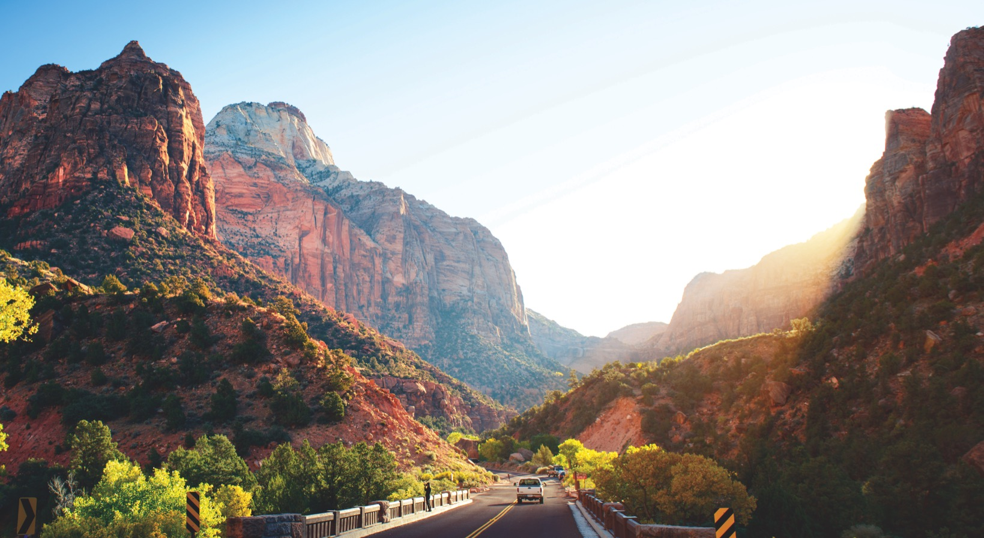

Slide 3
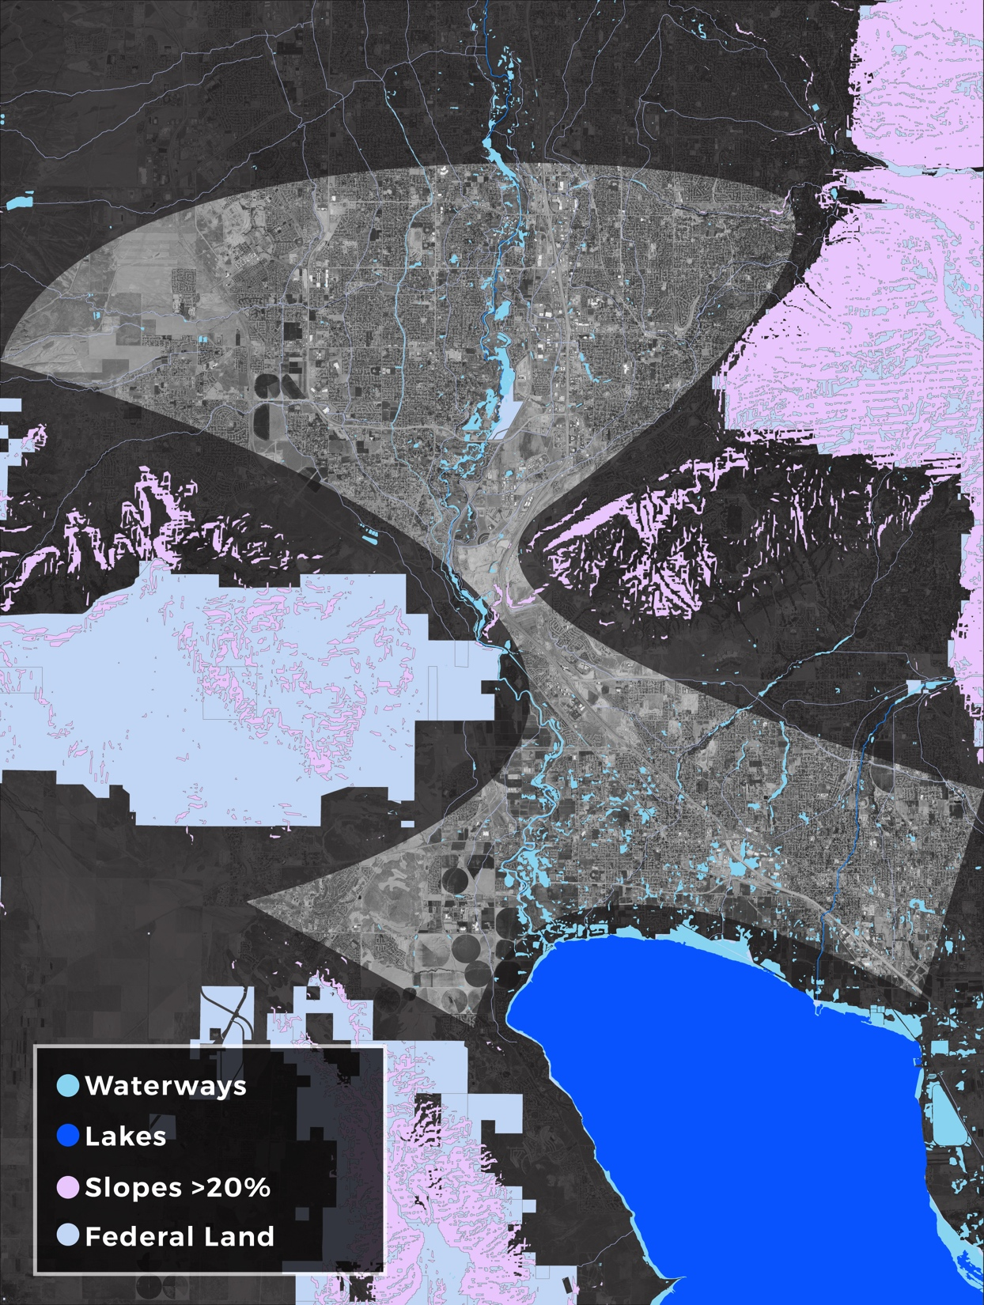
Salt Lake County 2050 Population: 1.5M People?
Utah County
2050 Population:
1.3M People?
Source: RCLCO
Notes:
In 2050, there could be 1.5 million people in Salt Lake County and 1.3 million in Utah County. This could be the worst bottleneck in the West or the best location to work, live, and grow a business.

Slide 4
Notes:
Nowhere else has this much land dead center in the middle of a major metro region growing this rapidly in between high-quality universities and surrounded by a growing workforce
We worked with San Diego, and they couldn’t find a place to grow new industry centers
We identified this area several years ago as critical to the future and as key to implementation of the statewide Your Utah, Your Future vision—the 20,000 acre number came from us
Excellent access (2 freeways, commuter rail, future light rail)
Economic growth engine:
the top place to grow a new business
Educated young, growing workforce
Rapidly growing
Great amenities
If we get it right, this can become the economic engine that powers Utah for the next century, a place we can be proud of
But if we get it wrong, this area can grind to a halt—literally

Slide 5
Notes:
Nowhere else has this much land dead center in the middle of a major metro region growing this rapidly in between high-quality universities and surrounded by a growing workforce
We worked with San Diego, and they couldn’t find a place to grow new industry centers
We identified this area several years ago as critical to the future and as key to implementation of the statewide Your Utah, Your Future vision—the 20,000 acre number came from us
Excellent access (2 freeways, commuter rail, future light rail)
Economic growth engine:
the top place to grow a new business
Educated young, growing workforce
Rapidly growing
Great amenities
If we get it right, this can become the economic engine that powers Utah for the next century, a place we can be proud of
But if we get it wrong, this area can grind to a halt—literally

Slide 6
Notes:
Nowhere else has this much land dead center in the middle of a major metro region growing this rapidly in between high-quality universities and surrounded by a growing workforce
We worked with San Diego, and they couldn’t find a place to grow new industry centers
We identified this area several years ago as critical to the future and as key to implementation of the statewide Your Utah, Your Future vision—the 20,000 acre number came from us
Excellent access (2 freeways, commuter rail, future light rail)
Economic growth engine:
the top place to grow a new business
Educated young, growing workforce
Rapidly growing
Great amenities
If we get it right, this can become the economic engine that powers Utah for the next century, a place we can be proud of
But if we get it wrong, this area can grind to a halt—literally

Slide 7
Purposes of the Effort Utah Code # 63C-17-104
Maximizing job creation
Ensuring a high quality of life for residents in and surrounding the project area
Strategic residential and commercial growth
Preservation of natural lands and expansion of recreational opportunities
Provision of a variety of community and housing types that match workforce needs
Planning for future transportation infrastructure and other investments to enhance mobility and protect the environment

Slide 8
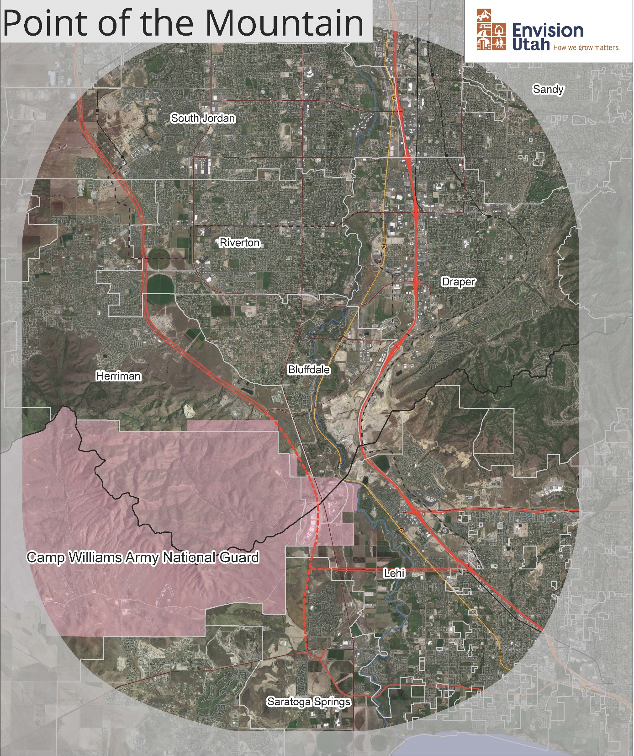
Project Area
“The area surrounding the border between Salt Lake County and Utah County, commonly referred to as the Point of the Mountain.”

Slide 9
Geographic constraints
Jordan River
Terrain slope
Environmentally sensitive areas (wetlands, etc.)
Hazard-prone areas
Federal Lands
NEW MAP GRAPHIC
Notes:
In 2050, there could be 1.5 million people in Salt Lake County and 1.3 million in Utah County. This could be the worst bottleneck in the West or the best location to work, live, and grow a business.

Slide 10
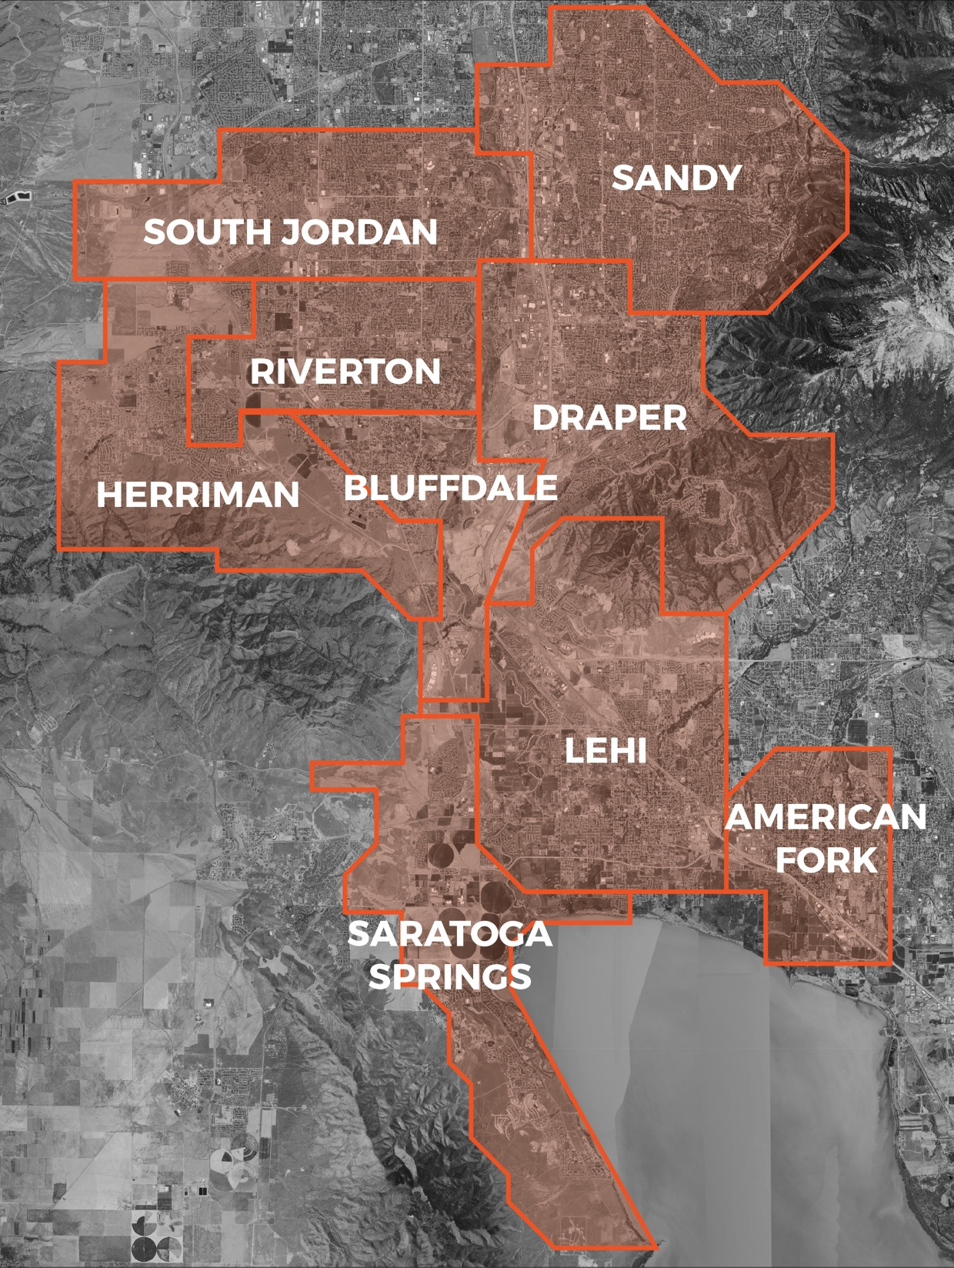
Many Jurisdictions
Bluffdale
South Jordan
Riverton
Herriman
Draper
Lehi
Saratoga Springs
Sandy
Salt Lake County
Utah County
State
Notes:
This is a complex area with many local government jurisdictions.
I can’t overemphasize the role of the cities.
They control land use and development within their boundaries, and a “one size fits all” vision won’t work.
Each city will choose its own future, although infrastructure must connect and the cities must work together.
A vision cannot be successful unless these jurisdictions believe in the vision.

Slide 11
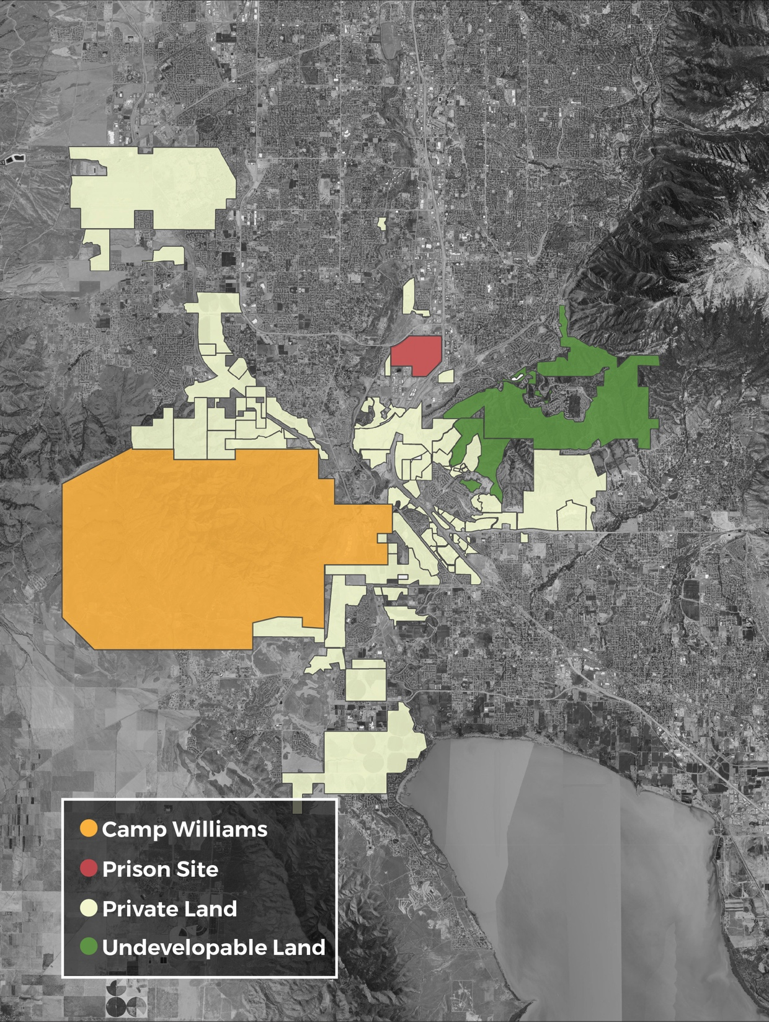
A Myriad of Landowners
Draper City [4,423 acres]
Daybreak [4,354]
LDS Church [3,833]
Micron [1,724]
Geneva Rock [1,026]
Lehi City [778]
Holbrook Farms/Ivory [776]
Shirley Butterfield [643]
DAI Investments [632]
Staker Parson [630]
Laguna Investments Company [629]
Prison Site [592]
Rosecrest Communities
Traverse/Truimph/Forge
Wasatch Properties
Western States Ventures
Perry & Associates
DR Horton
IM Flash
The Gardner Company
Camp Williams
NSA
Ebay
Young Living
DJ Investment Group
Thanksgiving Point
Boyer Company
Notes:
There are also many large landowners, including quite a few who own parcels larger than the prison site. These landowners will play a key role in deciding what happens, and their full participation is critical. Many have owned the land for decades waiting for this day to come. They are also Utahns who want to see this area succeed.
These are some of the long-term Utah developer families: the Gardners, the Plumbs, the Ivories, the Perrys, the Clydes.

Slide 12
Phase 1
Fall 2016-Spring 2017
Phase 2
Spring-Fall/Winter 2017
Scenario development and modeling
Phase 3
Winter 2017-2018
Funding strategy
Public engagement
Stakeholder organization
Public and stakeholder input on scenarios
Vision development
Final Report
Conceptual vision/goals
Research: markets, demographics, best practices
Implementation underway
DELIVERABLES:
Conceptual vision/goals
Analysis of best practices, markets, etc.
DELIVERABLES:
Well-analyzed scenarios and findings
Initial financing concepts
DELIVERABLES:
Vision and implementation plan
Implementation underway
Notes:
As you can see on this graphic, we’ve proposed a first phase that includes studying existing conditions, trends, and best practices, and working with the stakeholders and public to understand the conceptual vision and goals for the area. This phase could run roughly through the spring of 2017, with an interim report in 2016.
In the second phase, we work with the stakeholders and public to put more detail to the vision by creating and analyzing scenarios across a variety of topics. The stakeholders and public help create the scenarios, and their reaction to the scenarios leads to a more detailed vision, as well as implementation tools. This phase could run roughly through the fall of 2017.
The third phase involves preparing an implementation plan, including financing tools and recommendations. If desired, it may be possible to complete the final vision and implementation plan at the end of 2017.

Slide 14
Three Key Components of Success
Infrastructure
Land use
Infrastructure foundation
Placemaking
Culture
Convenience
Industry Ecosystem
Tuning the economic engine
Finance plan
Look and feel
Lifestyle choices
Green infrastructure & environment
Building the cluster
Workforce
Recreation
Education
Capital
Notes:
Achieving the area’s potential is a three-legged stool.
Infrastructure and land use are critical to make the area work.
Placemaking is essential to bring employees. This needs to be a place where people want to live and work.
And we need to make sure the industry cluster succeeds to bring business.

Slide 15
Biggest Challenges
Transportation -- congestion | 46
Funding (transportation) | 29
Land use coordination between markets, developers, cities, public | 21
Air quality | 19
Protecting the feel of the area, preserving open space | 19
Water supply & distribution | 15
Local jurisdiction coordination | 15
Housing affordability | 13
Recreational opportunities | 10
Ensure private sector success | 8
Not overshooting the market | 6
East-west transportation | 5
Public buy-in, credibility | 4
Overregulation of land use policy | 3
Conflicting interests | 2
Identity & placemaking | 1
Low connectivity | 1
NIMBYism | 1
Short Timeline | 1
Difficulty bringing infrastucture to region | 0
Attracting workers/younger generations to move to the region | 0

Slide 16
Big Ideas
High-tech university, Stanford-like, national scale/lab, National Research System | 38
Greenspace | 34
Innovative Transportation--electric vehicles/charging stations, self-driving vehicles, etc. | 26
Mixed-use developments | 18
Public transportation | 17
Recreation hubs for paragliding, skiing, mountain biking, Jordan River | 14
Live/work/play hubs | 13
Tax revenue source for open space | 12
Preserve East-West corridors | 11
Non-traditional zoning, moving away from euclidean zoning | 11
Regional placemaking and success, quality of life, jobs | 10
Entertainment & Amenities | 9
Double-track and electrify FrontRunner | 8
Tax Policy, state/local tax system | 7
Compatible borders between counties/jurisdictions | 5
Active transportation/connectivity | 5
Regional transportation - Change UTA Rules | 5
Second Downtown | 4
Gondola/tram connection to resorts | 3
Transit-oriented development | 2
Recognize the 'Utah model' | 2
Revitalize Utah Lake | 2
Collaborative education environment | 2
Globally-competitive environment | 1
Education for future workforce, workforce development center | 1
Shuttles | 1
Move Camp Williams | 0
New political entity | 0
Land aggregation | 0

Slide 17
Housing Mix

Slide 18
Enter Question Text
What percent of new units along the Wasatch Front should be
single family detached homes?
80-100%
60-80%
40-60%
20-40%
0-20%

Slide 19
Enter Question Text
What percent of new units in Draper and Lehi should be
single family detached homes?
80-100%
60-80%
40-60%
20-40%
0-20%

Slide 20
Enter Question Text
What would make a difference for housing? 1st choice
A wider variety of housing options
Allow more accessory dwelling units
Housing with multiple transportation options
A pattern of centers that bring destinations closer to homes
Provide additional opportunities for subsidized housing
Reduce regulatory burdens on housing

Slide 21
Enter Question Text
What would make a difference for housing? 2nd choice
A wider variety of housing options
Allow more accessory dwelling units
Housing with multiple transportation options
A pattern of centers that bring destinations closer to homes
Provide additional opportunities for subsidized housing
Reduce regulatory burdens on housing

Slide 22
Group Discussion
Is the region’s housing stock sufficient for current needs in 2017? In 2050?
What housing challenges do you foresee?
What can be done to ensure housing is affordable to the workforce in the area?
Describe the ideal housing environment that would attract employees to the Point of the Mountain area.

Slide 23
Enter Question Text
What percent of new units along the Wasatch Front should be
single family detached homes?
80-100%
60-80%
40-60%
20-40%
0-20%

Slide 24
Enter Question Text
What percent of new units in Draper and Lehi should be
single family detached homes?
80-100%
60-80%
40-60%
20-40%
0-20%

Slide 25
Enter Question Text
What would make a difference for housing? 1st choice
A wider variety of housing options
Allow more accessory dwelling units
Housing with multiple transportation options
A pattern of centers that bring destinations closer to homes
Provide additional opportunities for subsidized housing
Reduce regulatory burdens on housing

Slide 26
Enter Question Text
What would make a difference for housing? 2nd choice
A wider variety of housing options
Allow more accessory dwelling units
Housing with multiple transportation options
A pattern of centers that bring destinations closer to homes
Provide additional opportunities for subsidized housing
Reduce regulatory burdens on housing

Slide 27
What scenarios do we want to explore?

Slide 28
What do we want to test in the scenarios?
# of single family units
# of townhomes
# of condos and apartments
Income needed to afford new housing units
???

Slide 29
We Need Your Input!
Pointofthemountainfuture.org

